Slide 1
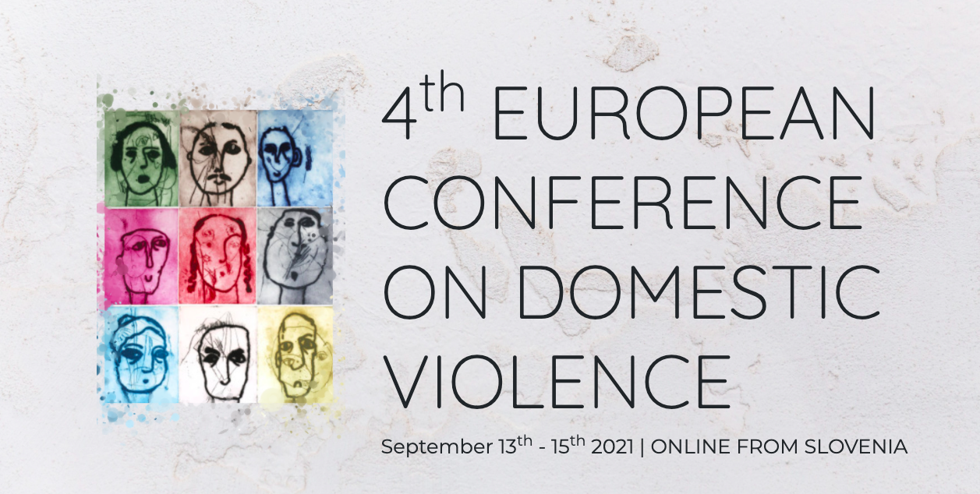
Improving the mental health of female IPV survivors:
A realist review
Paphitis, S. (King’s College London), Bentley, A. (University of Valencia), Asher, L. (University of Nottingham), Osrin, D. (University College London), Oram, S (King’s College London).

Slide 2
Introduction and Overview
A realist review of psychosocial interventions for women survivors of IPV
In this presentation we will:
Outline what a realist review is
Describe the model that we produced
Discuss key findings of the review
Outline research gaps identified
Notes:
Intimate partner violence (IPV) is highly prevalent and is associated with numerous mental health problems (1–3). Although a broad range of psychosocial interventions have been developed to support the recovery of women survivors (4), their mechanisms of action have not been explicitly examined. This report presents findings from a realist review of psychosocial interventions for women survivors of IPV and details a conceptual model of the mechanisms through which these interventions may improve mental health. Prospectively registered with PROSPERO and following the RAMESES reporting standards, the final synthesis and conceptual model draw on 60 review articles. The findings highlight aspects of intervention design and delivery that influence whether the different mechanisms lead to improvement in mental health, and the key steps that can be taken and knowledge gaps to be addressed to enable more successful design and implementation of psychosocial interventions for women survivors of IPV. The findings suggest that women’s mental health is most effectively supported by holistic, trauma-informed, and individualised interventions that are grounded in culture and context, honour the complexity of each woman’s situation, and seek to provide resources to address all her concerns. Alongside the selection of specific therapeutic components, researchers, advocates, and providers seeking to develop interventions to support the mental health of women survivors of IPV should critically consider the intervention’s design and delivery, as well as its core components to address survivors’ basic needs. In addition to improvements in coping and the use of therapeutic techniques, survivors need to feel safety, support and connection, a reduction in environmental stressors, and reductions in violence to heal and thrive.

Slide 3
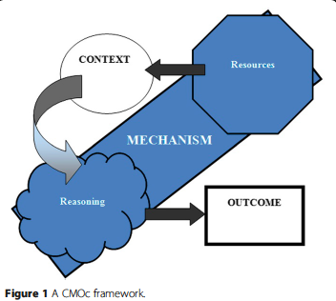
What is a realist review?
Causation within an intervention is grounded in its mechanisms of action
Source: Dalkin et al 2015
Notes:
Before we get into the details, it may be helpful to briefly outline what a realist review is and what this approach entails.
Realist syntheses examine how and why interventions may work in particular contexts or with particular populations (9). From a realist perspective, causation within an intervention is grounded in its mechanisms of action. Following this line of reasoning, a realist synthesis considers ‘families of mechanisms’ in answering the question of what works, rather than ‘families of interventions’ as is often the case with systematic reviews and meta-analyses (9).
Developed from the idea that it is the underlying components (or “resources”) within an intervention and the ways that individuals respond to them based on their circumstances that give rise to change, rather than the programmes themselves, a realist synthesis can begin to tell us how and why interventions may work in some contexts or for some populations (9). Mechanisms of action from this realist perspective comprise both resources and reasonings. Resources (material, social, cognitive, or emotional) are provided by intervention programmes to participants, making new options and choices available to them (10). Reasonings are the internal processes of the participants (be they survivors, perpetrators, service providers, or the wider community) that can contribute to change as a result of having access to resources.
Synthesising evidence through a realist perspective can therefore produce Context-Mechanism-Output (CMO) statements that describe why and how components from different programmes work. These CMO statements become the unit of comparison that allow us to evaluate inconsistencies and develop programme theories. From the realist perspective, both the resources and reasoning components of the mechanisms of change in an intervention must be understood in order to capture the underlying causality at work (10).

Slide 4
Scope and Methods of our Review
Aim: to conduct a realist synthesis of psychosocial interventions that may improve the mental health of survivors of IPV
Exploratory Scoping
10 review articles to build initial model
Searching, Selection and Appraisal
Limited to reviews. 8360 screened, 60 included
Analysis and Synthesis
Iterative thematic analysis. 272 CMOs condensed to 73. Refined and tested conceptual model
Notes:
In our realist review, we wanted to understand the mechanisms of action underlying psychosocial interventions that improve the mental health of survivors of intimate partner violence. This was with a view to contributing to the development of a package of care for survivors of violence within our wider research group.
Exploratory scoping
To begin a realist review, an initial exploratory scoping exercise is conducted to produce a preliminary conceptual model with which to guide the review.
Searching, selection and appraisal process
From the exploratory scoping and mapping exercise, we identified that there are a broad range of multi-component interventions aiming to improve the mental health of survivors of IPV and a vast number of reviews assessing them. We focussed our search and CMO development on the evidence available at review level as this allowed us to consider mechanisms across a broad variety of domains. We searched a variety of databases for peer reviewed articles, as well as conducting a search of the grey literature and hand searches.
Analysis and synthesis
We independently coded the extracted text using a thematic approach. We tested and refined the initial conceptual model through iterative analysis to produce middle range theories comprising connections between resources and reasonings within families of mechanisms.
From the analysis, we developed CMO configurations that were categorised into families of mechanisms. We triangulated our findings through two stakeholder engagement workshops.

Slide 5
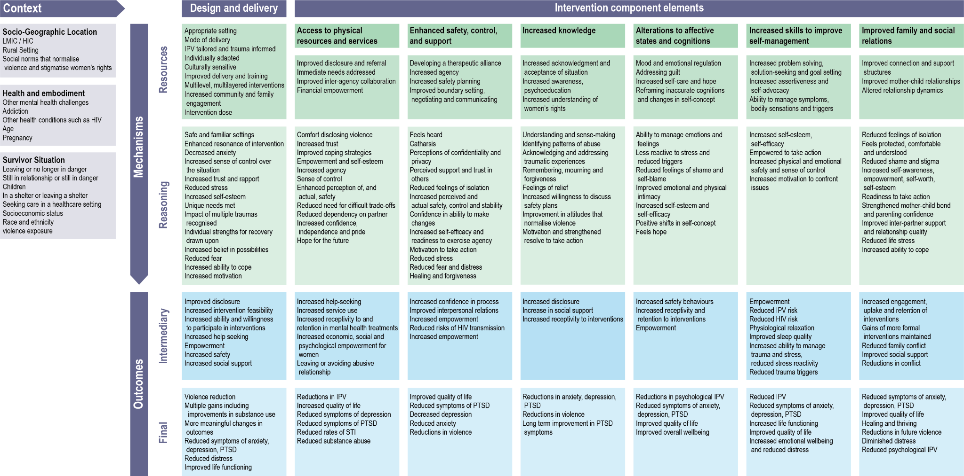
Our Model
Notes:
The conceptual model summarises the contexts, mechanisms, and outcomes identified across a broad range of psychosocial interventions, highlighting the program resources as well as survivor and service provider reasonings underlying each mechanism. The model allows us to see behind the veil of a particular intervention to understand the individual components of programmes, and may be used to assist in the design of complex interventions to improve the mental health of women survivors of IPV.
Given the inclusive nature of the review, our model highlights a range of intermediary and final outcomes in addition to mental health that are important for women’s improved wellbeing, recovery, and healing. These include reduced risk of violence, reductions in family conflict, improved interpersonal relations, economic, social, and psychological empowerment, improvements in self-concept, and strengthening of social support.
While we do not have time to give a detailed discussion of this model, the key aspect we would like to discuss for this presentation is the identification of overall families of mechanisms.

Slide 6
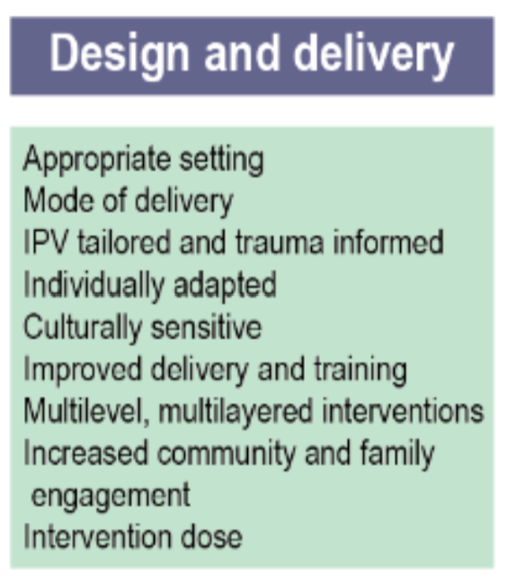
Families of Mechanisms
Notes:
Mechanisms have been broadly split into two sections: those detailing the design and delivery of interventions, and those detailing intervention component elements.
The model is grounded in design and delivery mechanisms that increase the feasibility, acceptability, and effectiveness of the intervention components.
Six families of mechanisms emerged under the intervention component element section.
Taken together, these families of mechanisms provide a coherent and comprehensive model describing how IPV interventions can help survivors move towards recovery and improved mental health.
Design and Delivery
The ‘where, how, who, and how long’ of the design of interventions affect their feasibility, acceptability and buy-in, which in turn affect their outcomes. For example, finding a balance between intervention accessibility—particularly for marginalised populations—and privacy and safety is important for uptake and retention (5–16). Culturally sensitive interventions with engaged approaches that foster community partnerships can improve survivor trust in interventions and community support for survivors (6,8,10–12,17–26). Interventions that are multi-layered and cut across a range of underlying problems can lead to gains in multiple outcomes, as well as improving the accessibility of services for women who have multiple and complex needs, including complex mental health problems (8,14,16,17,29,31–34).
Access to resources and services
This family of mechanisms operate by reshaping the survivor’s World-Self relationship. Reshaping the World-Self relationship takes place through increased access to resources and the availability of viable life options to address the survivor’s situation, which leads to increased agency and self-efficacy. Increasing a woman’s access to resources includes addressing her immediate needs and financial independence, and facilitates access to services via effective identification, referrals, and interagency collaboration. Ensuring access to resources and services also allows women to focus on healing from their experiences rather than on navigating complex situations and systems that may hinder their recovery (7,16–18,27,33,35,36).
Enhanced safety, control and support
This family of mechanisms operate by reshaping Other-Self relations. Reshaping Other-Self relations takes place through supportive and collaborative efforts that empower survivors to maximise their safety, leading to increases in their agency and self-efficacy. Prioritising survivor safety is crucial. Increased safety may be achieved through concerted efforts to set boundaries, negotiate and communicate effectively, and plan actively for safety. This is further advanced through the development of a therapeutic alliance between survivor and service-provider. Women’s increased control, or perception of control, over their situation–including through increased capacity to make choices over the intervention and recovery process—can also contribute to improvements in safety and self-efficacy, leading to improvements in mental health.
Increased knowledge
This family of mechanisms operate through growth in the survivor’s Epistemic-Self: expanding what survivors know and understand about abuse and available resources, reframing how they interpret and make meaning of the world and their experiences, and increasing their ability to use this knowledge and understanding for personal sense-making, self-advocacy, and healing, can increase their epistemic agency. Coming to understand and make personal sense of violence can help women reach a place of acknowledgement, acceptance, and sometimes even forgiveness, which can play an important role in their recovery (11,12,17,27,32,33,37).
Alterations to affective states and cognitions
This family of mechanisms operate by reshaping survivors’ Self-Self relations.Reshaping Self-Self relations takes place through a variety of activities centred on developing and supporting women’s inner resources. Managing their internal states and reframing misconceptions about themselves can increase survivors’ self-esteem and hope, bringing about positive shifts in self-concept and improvements in mental health. This process can be supported by a variety of activities centred on developing and supporting women’s inner resources, including learning skills to manage emotions, coming to understand and heal from traumatic experiences, learning ways to understand and overcome intruding thoughts, guilt, and shame, and modifying and reversing a range of unhelpful beliefs, misconceptions, and patterns of thinking (17,19,35–38).
Increased skills to improve self-management
This family of mechanisms operate by reshaping and enhancing survivors' Self-World relations, allowing them to manage and regain control over internal states that shape their actions and behaviours in the world. Intervention components that help women to improve their self-management skills can increase their sense of control, self-efficacy and safety, leading to improvements in mental health. Such skills may include setting personal goals, seeking solutions, solving problems, managing symptoms and triggers, and being assertive and advocating for themselves (7,14–17,20,25,28,33,35,37,39–43).
Improved family and social relations
This family of mechanisms operate by enhancing survivors’ Self-Other relations. Improved social connections help survivors to feel supported, increasing self-esteem and feelings of self-worth and leading to improvements in both willingness and ability to cope and to act. Social connections can be enhanced through group therapy and by actively assisting survivors in building informal support networks (8,12,17,20,23,24,27,36,44,45). Strengthening relationships within couples and between mothers and children leads to changes in relationship dynamics that can reduce conflict and lead to improved mental health outcomes (12,15–17,19,29,31,38,40,46–49).

Slide 7
Key Lessons
Self-efficacy, agency and empowerment are important in adaptive coping strategies
Design and delivery are important considerations in intervention development
Social connections are key
Interventions should be culturally relevant, individually adapted, IPV-tailored and trauma-informed
Safety, practical and psychosocial concerns all need to be addressed
A holistic approach to healing is essential
Notes:
· Factors supporting survivors’ adaptive coping strategies include self-efficacy, agency, and empowerment. These strategies are interrelated and all play a part in shaping survivors’ beliefs and attitudes (internal reasoning) about their ability to effectively plan and manage changes to their situations.
· Multiple mechanisms across a range of interventions have, at their core, the development and strengthening of social connections. These include the importance of building therapeutic alliances and of fostering perceived or actual social support, and the effectiveness of group and mother-child interventions.
· Fully supporting the recovery of women survivors of IPV requires interventions to address the range of safety, practical, and psychosocial concerns that women present with. Safety and material and psychological stabilisation should be addressed prior to the provision of specialised therapeutic care.
· Careful consideration should be given to intervention design and delivery, regardless of the specific psychological therapy that may be selected. As well as increasing the likelihood of intervention acceptability, uptake, and retention, the design and delivery of the interventions themselves have a significant bearing on mental health outcomes.
· Interventions that are culturally-relevant, individually adapted, tailored to IPV, and trauma-informed are likely to yield the best results.
· Comprehensive IPV interventions that incorporate multiple mechanisms (i.e., multi-layered interventions) are the most effective: interventions should aim to incorporate as many mechanisms as are feasible. Resource constraints that could limit this aim might be addressed through developing partnerships and referral pathways between services.
· Multi-layered interventions that operate through multiple mechanisms and address the variety of challenges faced by survivors in an integrated way can lead to increased access to resources, reduced violence, and improved mental health. A failure to follow a multi-layered approach can prevent some of the most vulnerable women—particularly those with complex mental health needs—from accessing relevant services.

Slide 8
Research Gaps
Couples-based education and therapeutic activities
Impact of systematic and institutional prejudice on service provision
Healing and thriving beyond IPV
Notes:
· Women in abusive relationships will often not want to leave their partners and may seek to improve the dynamics within their current relationships. Couples-based educational activities and therapeutic activities warrant further attention and consideration, including when and how they can be provided safely.
· Harmful stereotypes about certain groups of survivors may create barriers to culturally sensitive interventions. One well documented example of this is among African American female survivors of IPV, where harmful consequences of the perpetuation of the “Black Superwoman” stereotype prevents society from seeing African American women as vulnerable, limiting empathetic concern for victims even among mental health professionals, and contributes to a lack of advocacy (26). Future studies should aim to explore these stereotypes and the impact of provider and institutional prejudice on provision of services for survivors of IPV.
· Realist evaluations of integrated alcohol use and IPV interventions are needed to understand the mechanisms through which addressing alcohol use in perpetrators and survivors can reduce the risk of IPV and improve mental health.
· Interventions rarely focus on positive mental health (versus being symptom-free) or on helping survivors to thrive. Interventions that focus on addressing guilt, increasing self-care and hope, reframing inaccurate cognitions, and changing self-concept could play an important part in assisting survivors in developing skills for long-term flourishing and support them in their journey to regaining a sense of meaning in life. Resources are needed to develop and test such interventions.

Slide 9
Thank you!
Paphitis, S. (King’s College London) sharli.paphitis@kcl.ac.uk
Bentley, A. (University of Valencia) a.bentley.12@alumni.ucl.ac.uk

